Slide 1
Python for Life Sciences
Kulwadee Somboonviwat
kulwadee.a [at] gmail.com
PyCon Thailand 2018-06-16
Slide available at: https://goo.gl/6fqDAL

Slide 2
Me
Current
Software developer working on bioinformatics and dialog systems
Past
Faculty member at KMUTNB, KMITL, KMUTT
Specially Appointed Assoc.Prof. at University of Electro-Communications (UEC)
Technical consultant (PEA)
Part-time researcher at CoE for Molecular Biology and Genomic of Shrimp (CU)
Ph.D. in Information and Communication Engineering (Univ. of Tokyo)

Slide 3
Today’s Topics
Why Python for Life Sciences?
Important Concepts
The Central Dogma of Molecular Biology
Types of Biological Data
Common Tasks in Bioinformatics
Python Libraries and Tools
Example: Gene Expression Analysis
Key Issues in doing Biological Data Science (a computer scientist perspective)

Slide 4
Life Sciences is a Big Data Science.

Slide 5
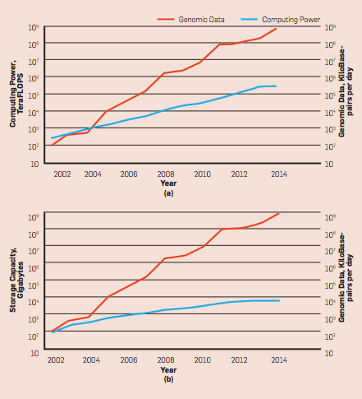
Explosion of Genomic Data
With the advent of NGS in 2004…
Cost-per-Genome → US$1000
10x yearly growth rate of Genomic Data
The First Human Genome sequenced
Computing Power - TeraFLOPS
Genomic Data (Kbp per day)
Next Generation Sequencing (NGS)
https://www.genome.gov/27565109/the-cost-of-sequencing-a-human-genome/
B., Bonnie, N. M. Daniels, and Y. W. Yu. "Computational Biology in the 21st Century: Scaling with Compressive Algorithms." CACM 59.8: 72-80.

Slide 6
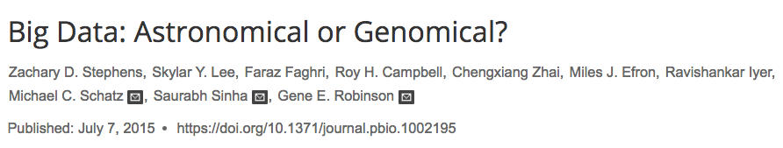
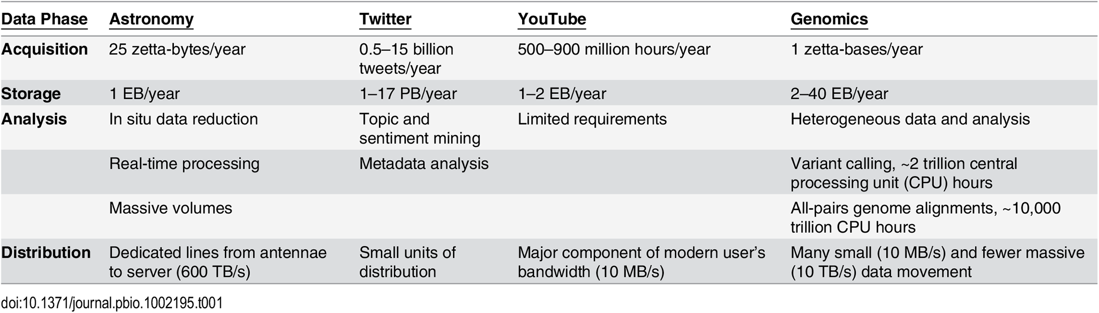
“Genomics is either on par with or the most demanding of the domains analyzed (Astronomy, Twitter, YouTube) in terms of data acquisition, storage, distribution, and analysis. ”

Slide 7
Biological Data Science has huge impact on society.

Slide 8

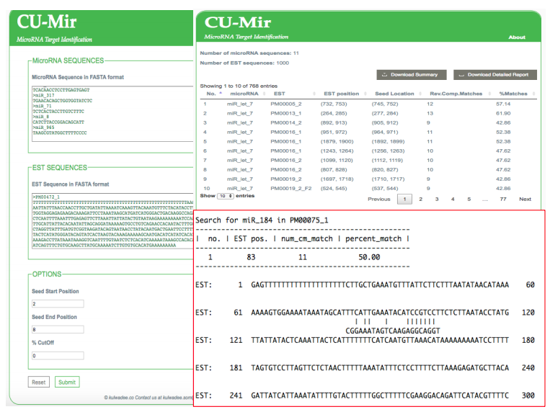
THAILAND SHRIMP INDUSTRY
Outbreak of shrimp diseases in 2012 to 2015 had caused Thai shrimp production plummeted as much as 40%
https://goo.gl/3PytXP
629K LABORERS
https://goo.gl/BCAcfH
CU-Mir is a miRNA target identification program, written in Python.
Help scientists to be more productive by lowering time and costs of experiments
https://www.ncbi.nlm.nih.gov/pubmed/26945623

Slide 9

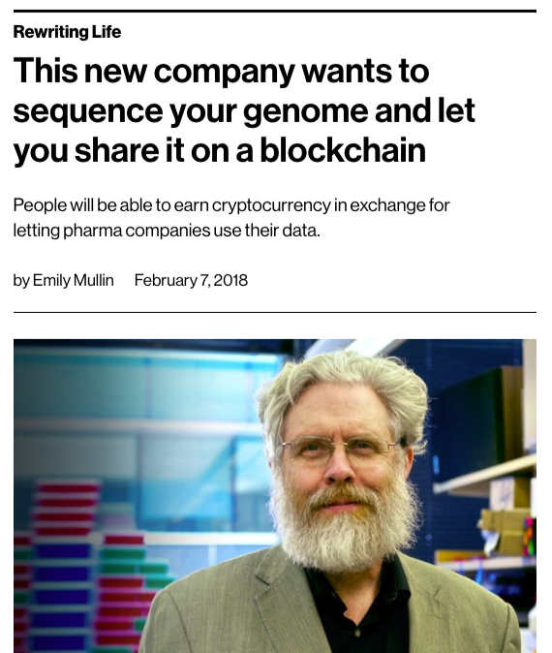
Other emerging applications …
https://nanoporetech.com/applications
https://goo.gl/gnVMuZ
https://goo.gl/oisL5o

Slide 10
Today’s Topics
Why Python for Life Sciences?
Important Concepts
The Central Dogma of Molecular Biology
Types of Biological Data
Common Tasks in Bioinformatics
Python Libraries and Tools
Example: Gene Expression Analysis
Key Issues in doing Biological Data Science (a computer scientist perspective)

Slide 11
The Central Dogma of Molecular Biology
All information needed to run a cell is kept in DNA.
To access this information, the DNA is transcribed into RNA.
And, RNA is translated into protein
Video animation by RIKEN:
https://www.youtube.com/watch?v=J3HVVi2k2No

Slide 12
Types of Biological Data
DNA, RNA, Protein Sequences
Gene Expression
Networks and Pathways
Gene Ontology

Slide 13
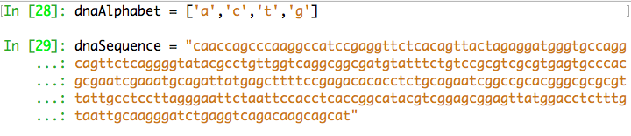
Types Biological Data – DNA sequence
base pair
https://www.thoughtco.com/dna-vs-rna-1224518

Slide 14
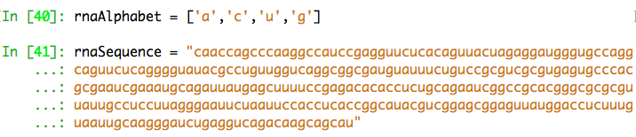
Types Biological Data – RNA sequence
helix of sugar-phosphates
https://www.thoughtco.com/dna-vs-rna-1224518

Slide 15
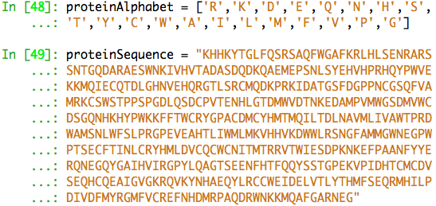
Types Biological Data – Protein
http://knowgenetics.org/genetic-code/

Slide 16
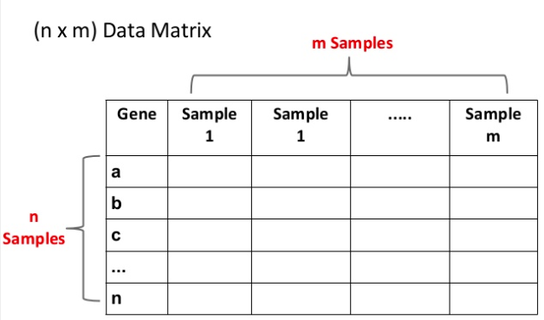
Types Biological Data – Gene Expression
Gene. A stretch of DNA that codes for a type of protein that has a function in an organism
Gene Expression Data. Expression level of genes in an individual that is measured through Microarray

Slide 17
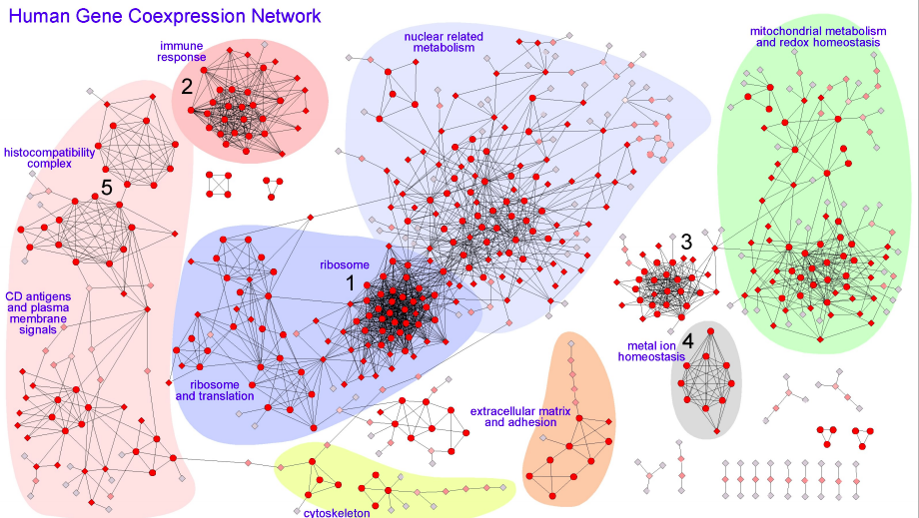
Types Biological Data – Networks and Pathways
Co-Expression Network
Protein-Protein Interaction Network
For more details, pls. refer to https://goo.gl/mnAL1f

Slide 18
Types Biological Data – Gene Ontology
Gene Ontology defines the universe of concepts relating to gene functions (‘GO terms’), and how these functions are related to each other (‘relations’).
http://geneontology.org/page/ontology-documentation

Slide 19
Today’s Topics
Why Python for Life Sciences?
Important Concepts
The Central Dogma of Molecular Biology
Types of Biological Data
Common Tasks in Bioinformatics
Python Libraries and Tools
Example: Gene Expression Analysis
Key Issues in doing Biological Data Science (a computer scientist perspective)

Slide 20
Python Libraries and Tools
Jupyter Notebook
scipy, numpy, matplotlib, pandas
scikit-learn, scikit-image
rpy2
biopython, scikit-bio

Slide 21
Differential Expression Analysis with Python and Bioconductor
Credits: https://goo.gl/XPV6Ji
Use numpy to store expression data
Interface with Bioconductor (an R package) via rpy2

Slide 22
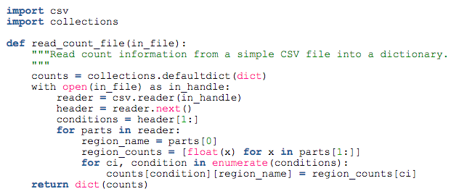
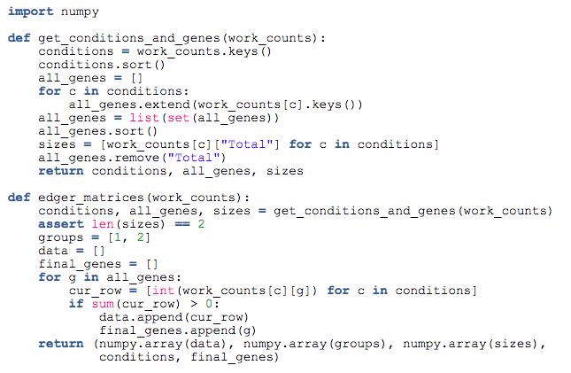
# Read Expression Data and Store it in numpy array

Slide 23
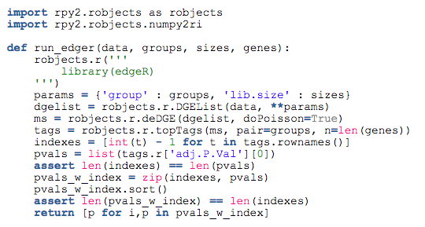
# Use rpy2 to access a DGEList and call topTags function in R

Slide 24
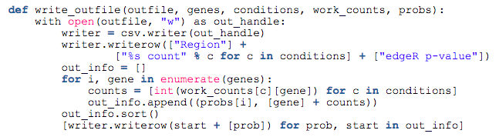
# Write output to a csv file

Slide 25
Today’s Topics
Why Python for Life Sciences?
Important Concepts
The Central Dogma of Molecular Biology
Types of Biological Data
Common Tasks in Bioinformatics
Python Libraries and Tools
Example: Gene Expression Analysis
Key Issues in doing Biological Data Science (a computer scientist perspective)

Slide 26
Key Issues in doing Biological Data Sciences
Domain knowledge refer to Getting Started Resources on next slide
Interoperability between languages (R⬄Python)
Heterogenous data types and formats data types. DNA/RNA/Protein sequences, gene expression, network, .. DB formats. e.g. GenBank, EMBL, SWISSPROT/TrEMBL sequence analysis formats. e.g. FASTA, MSA, ClustalW, GFF2 Ref: http://rice.plantbiology.msu.edu/training/Childs_Data_Formats.pdf
Large proportion of time spent in data preprocessing and wrangling
Customized software solutions are needed

Slide 27
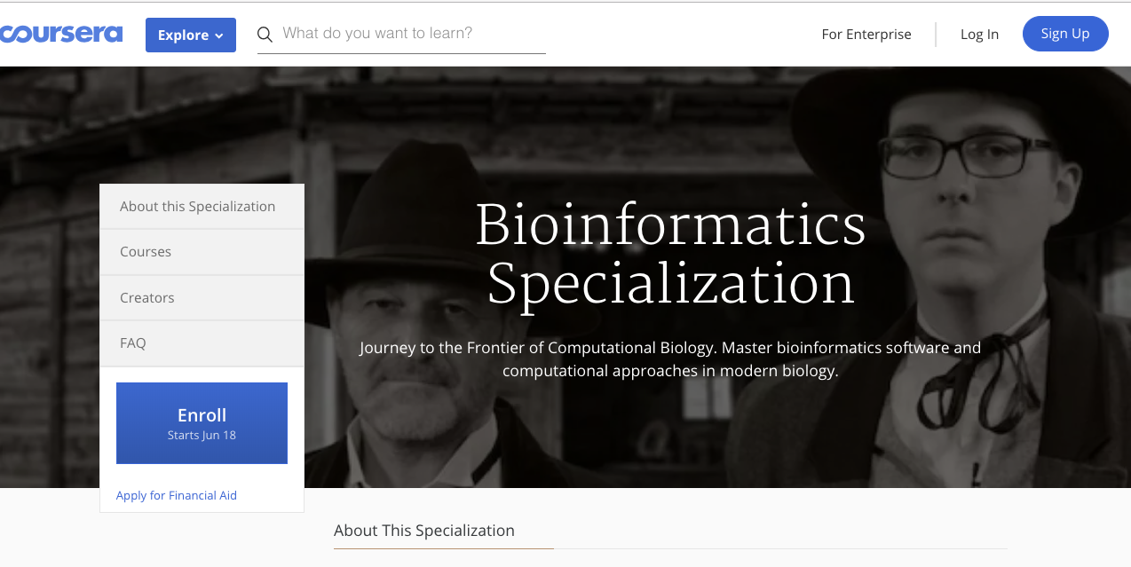
Resources for Getting Started

